Slide 2


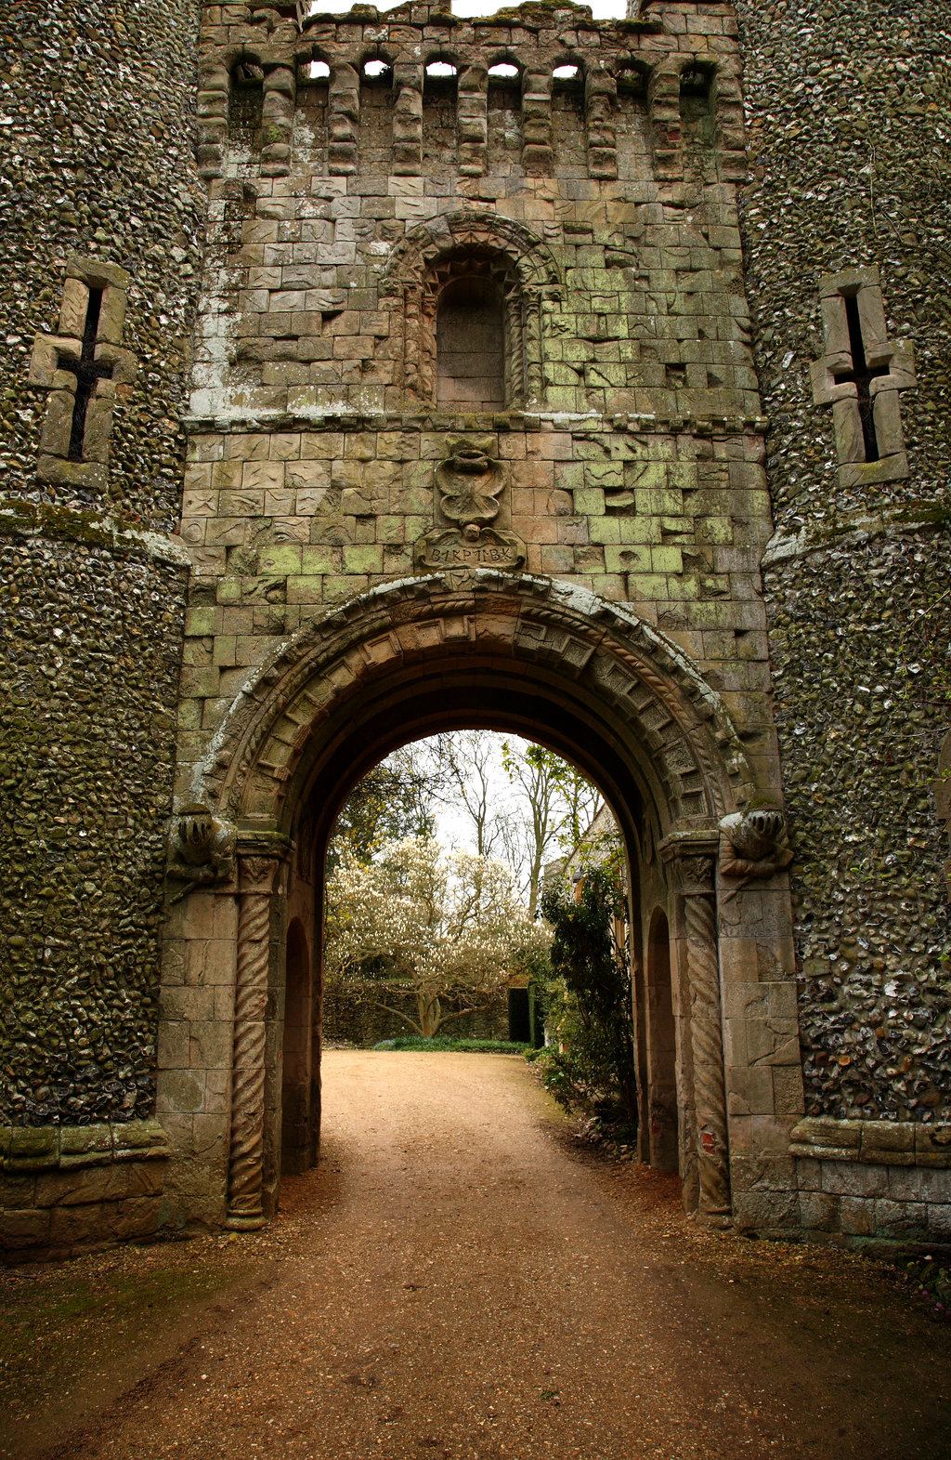
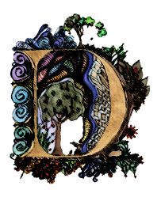

The Dark Ages
Part 4: The Crusades and the Carta
ARK AGES
ARK AGES
What makes a hero?

Slide 3
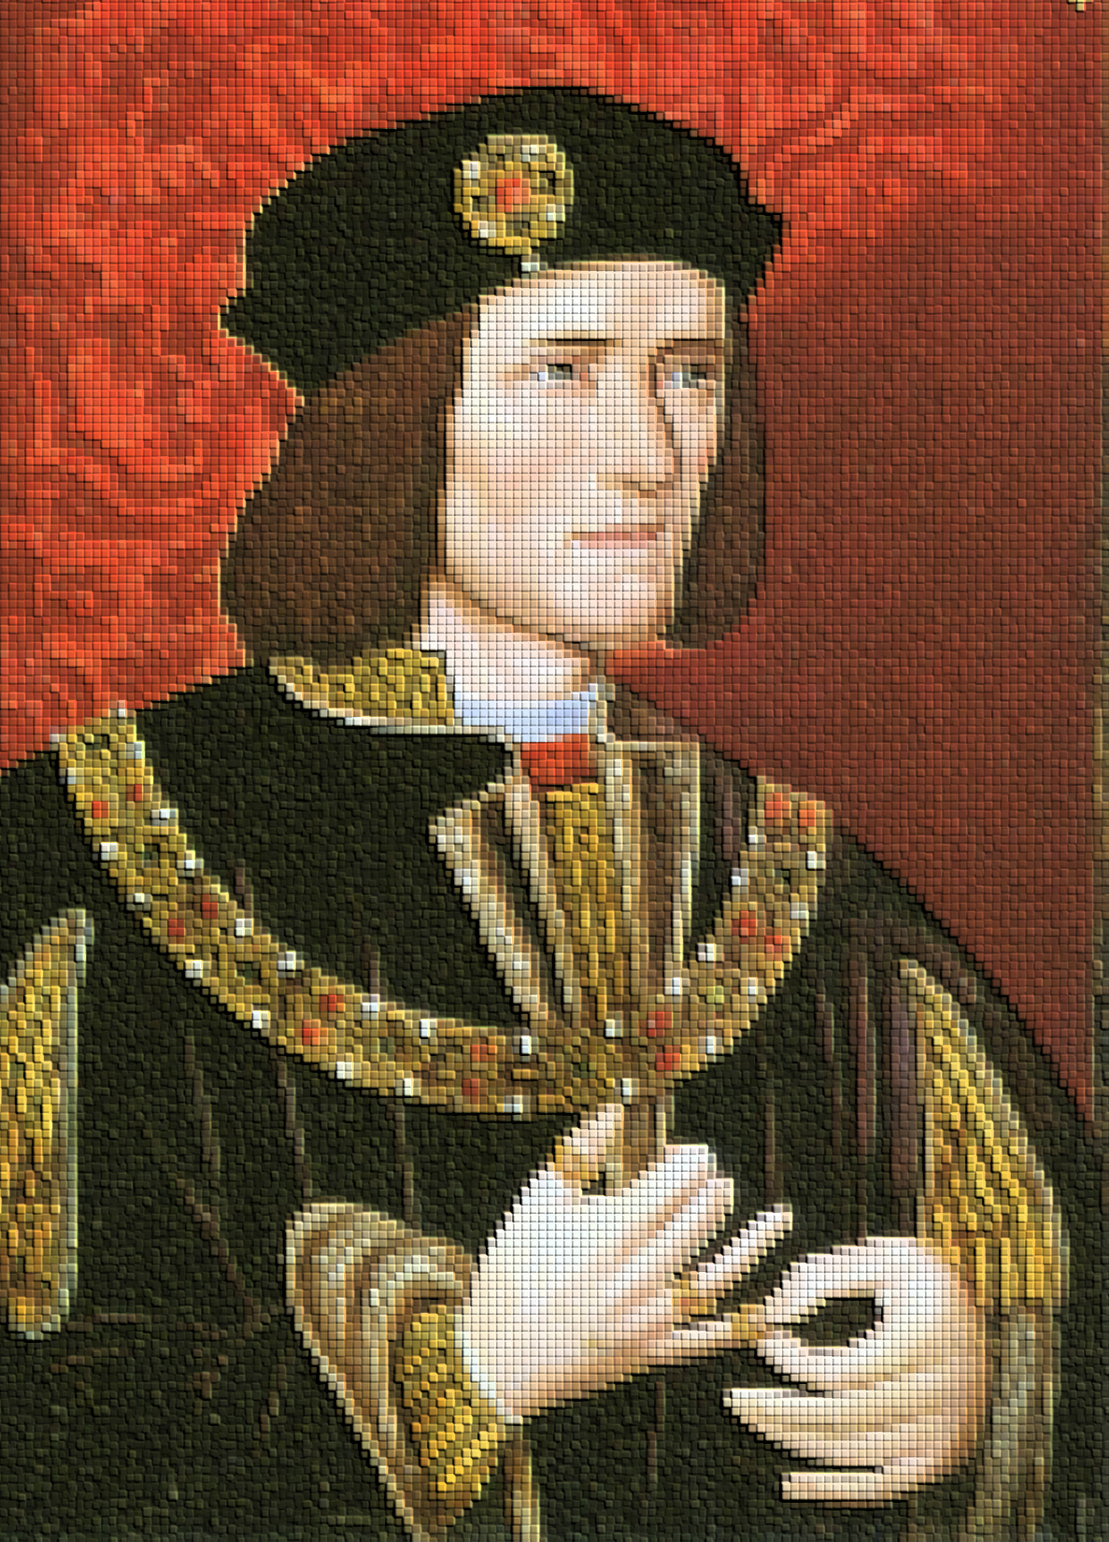
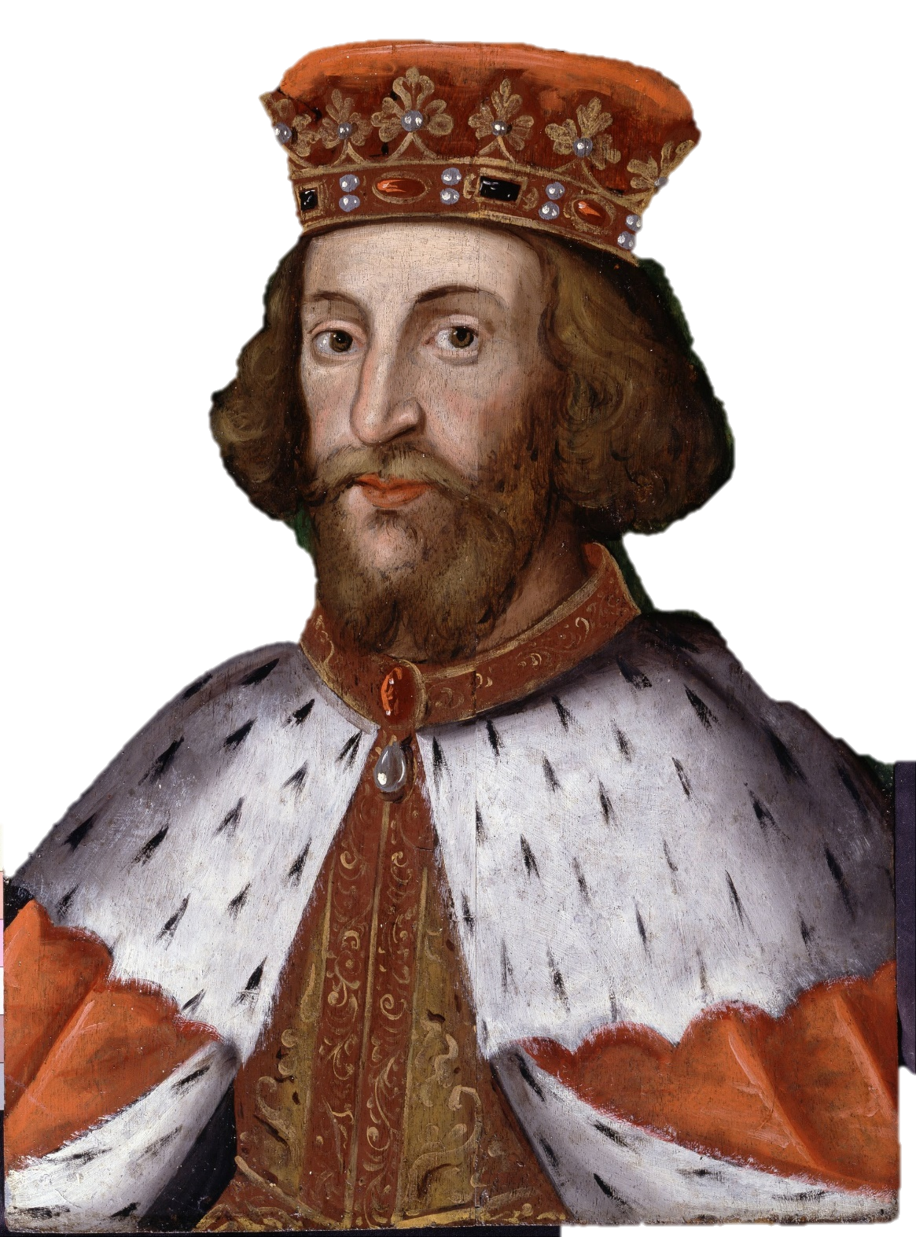
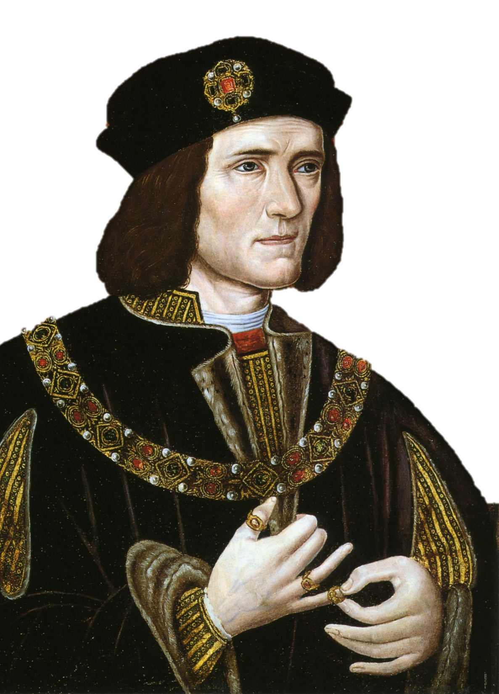
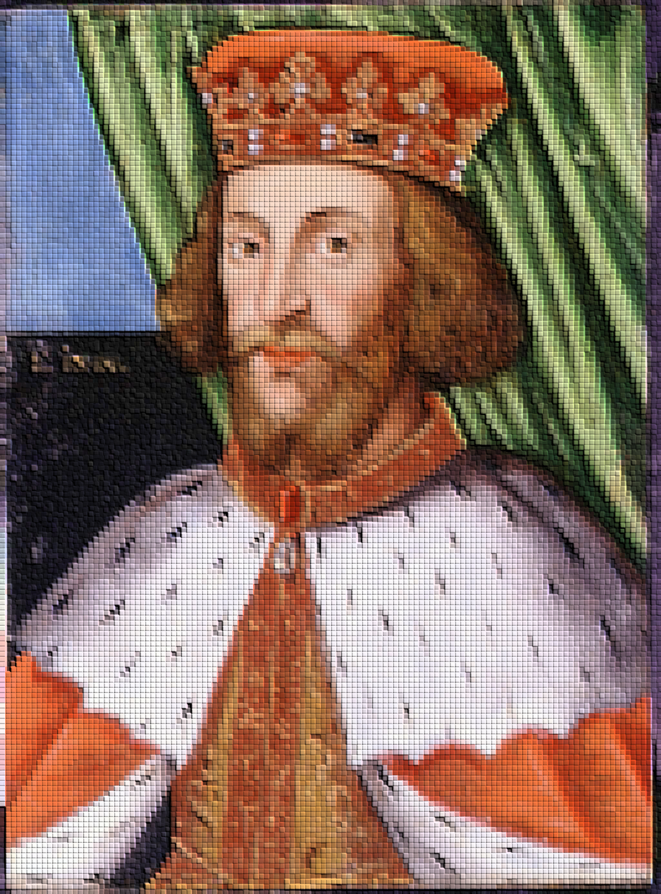
Richard and John
ARK AGES
ARK AGES
What makes a hero?
What makes a hero?

Slide 4

The Crusades
Notes:
7.6.6

Slide 5
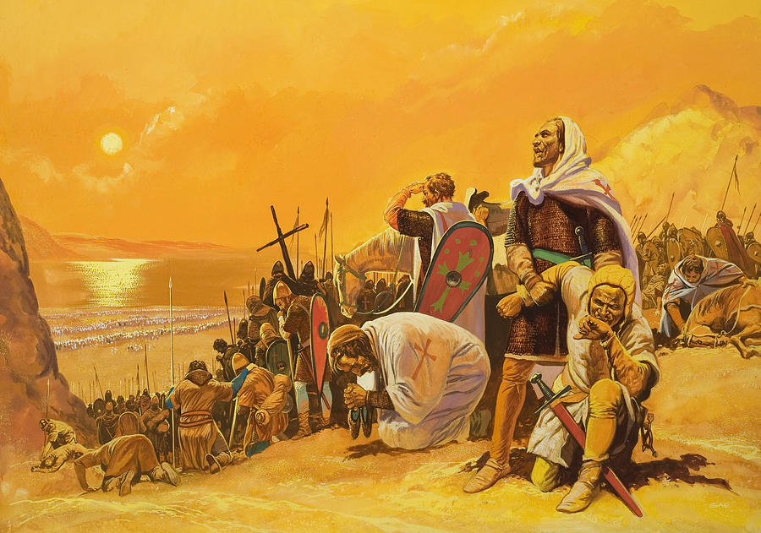
A religious war to regain the holy land (Jerusalem) for Christians.
ARK AGES
What makes a hero?
Notes:
5
7.6.6

Slide 6

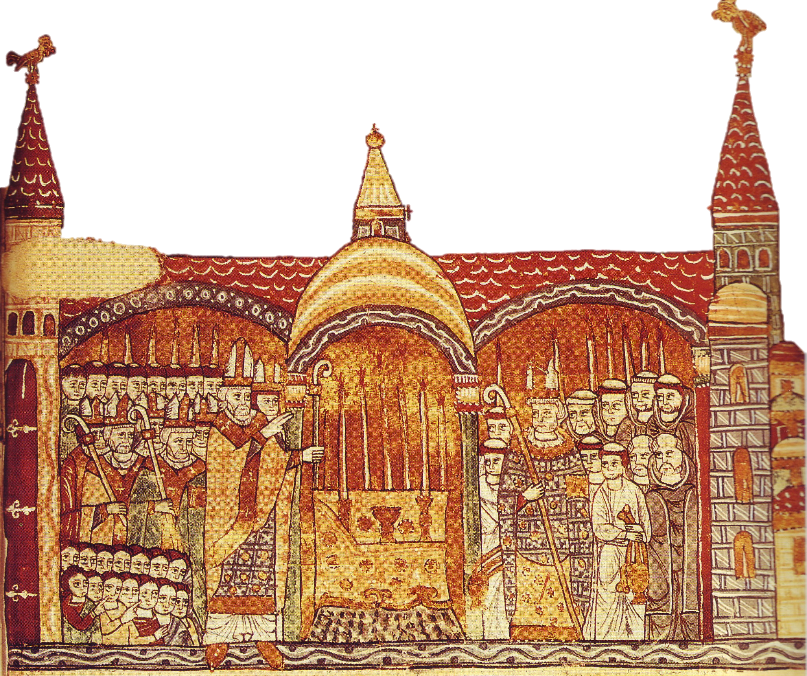
“All who die shall have immediate salvation.”
“Go with God as your guide.”
ARK AGES
What makes a hero?

Slide 7
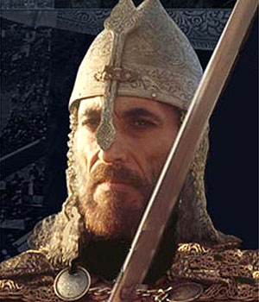
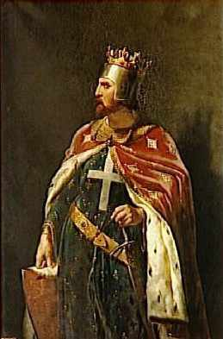




The Battles
1st Crusade: Conquered Jerusalem and held it for almost 100 years.
2nd: Muslim leader Saladin retakes Jerusalem
3rd: King Richard fights Saladin – and loses.
4th-8th:Crusaders lose more.
ARK AGES
What makes a hero?
Notes:
7
7.6.6

Slide 8
Crusade Results
Holy land remains under Arab control.
Europeans realized there was much more to the world than they ever knew
Trade and technology expanded: gun powder, coffee, etc.
Europe became more unified as the knights now had a common enemy.
Ahh, I wuv you too French guy!
I wuv you German guy!
ARK AGES
What makes a hero?
Notes:
8

Slide 9
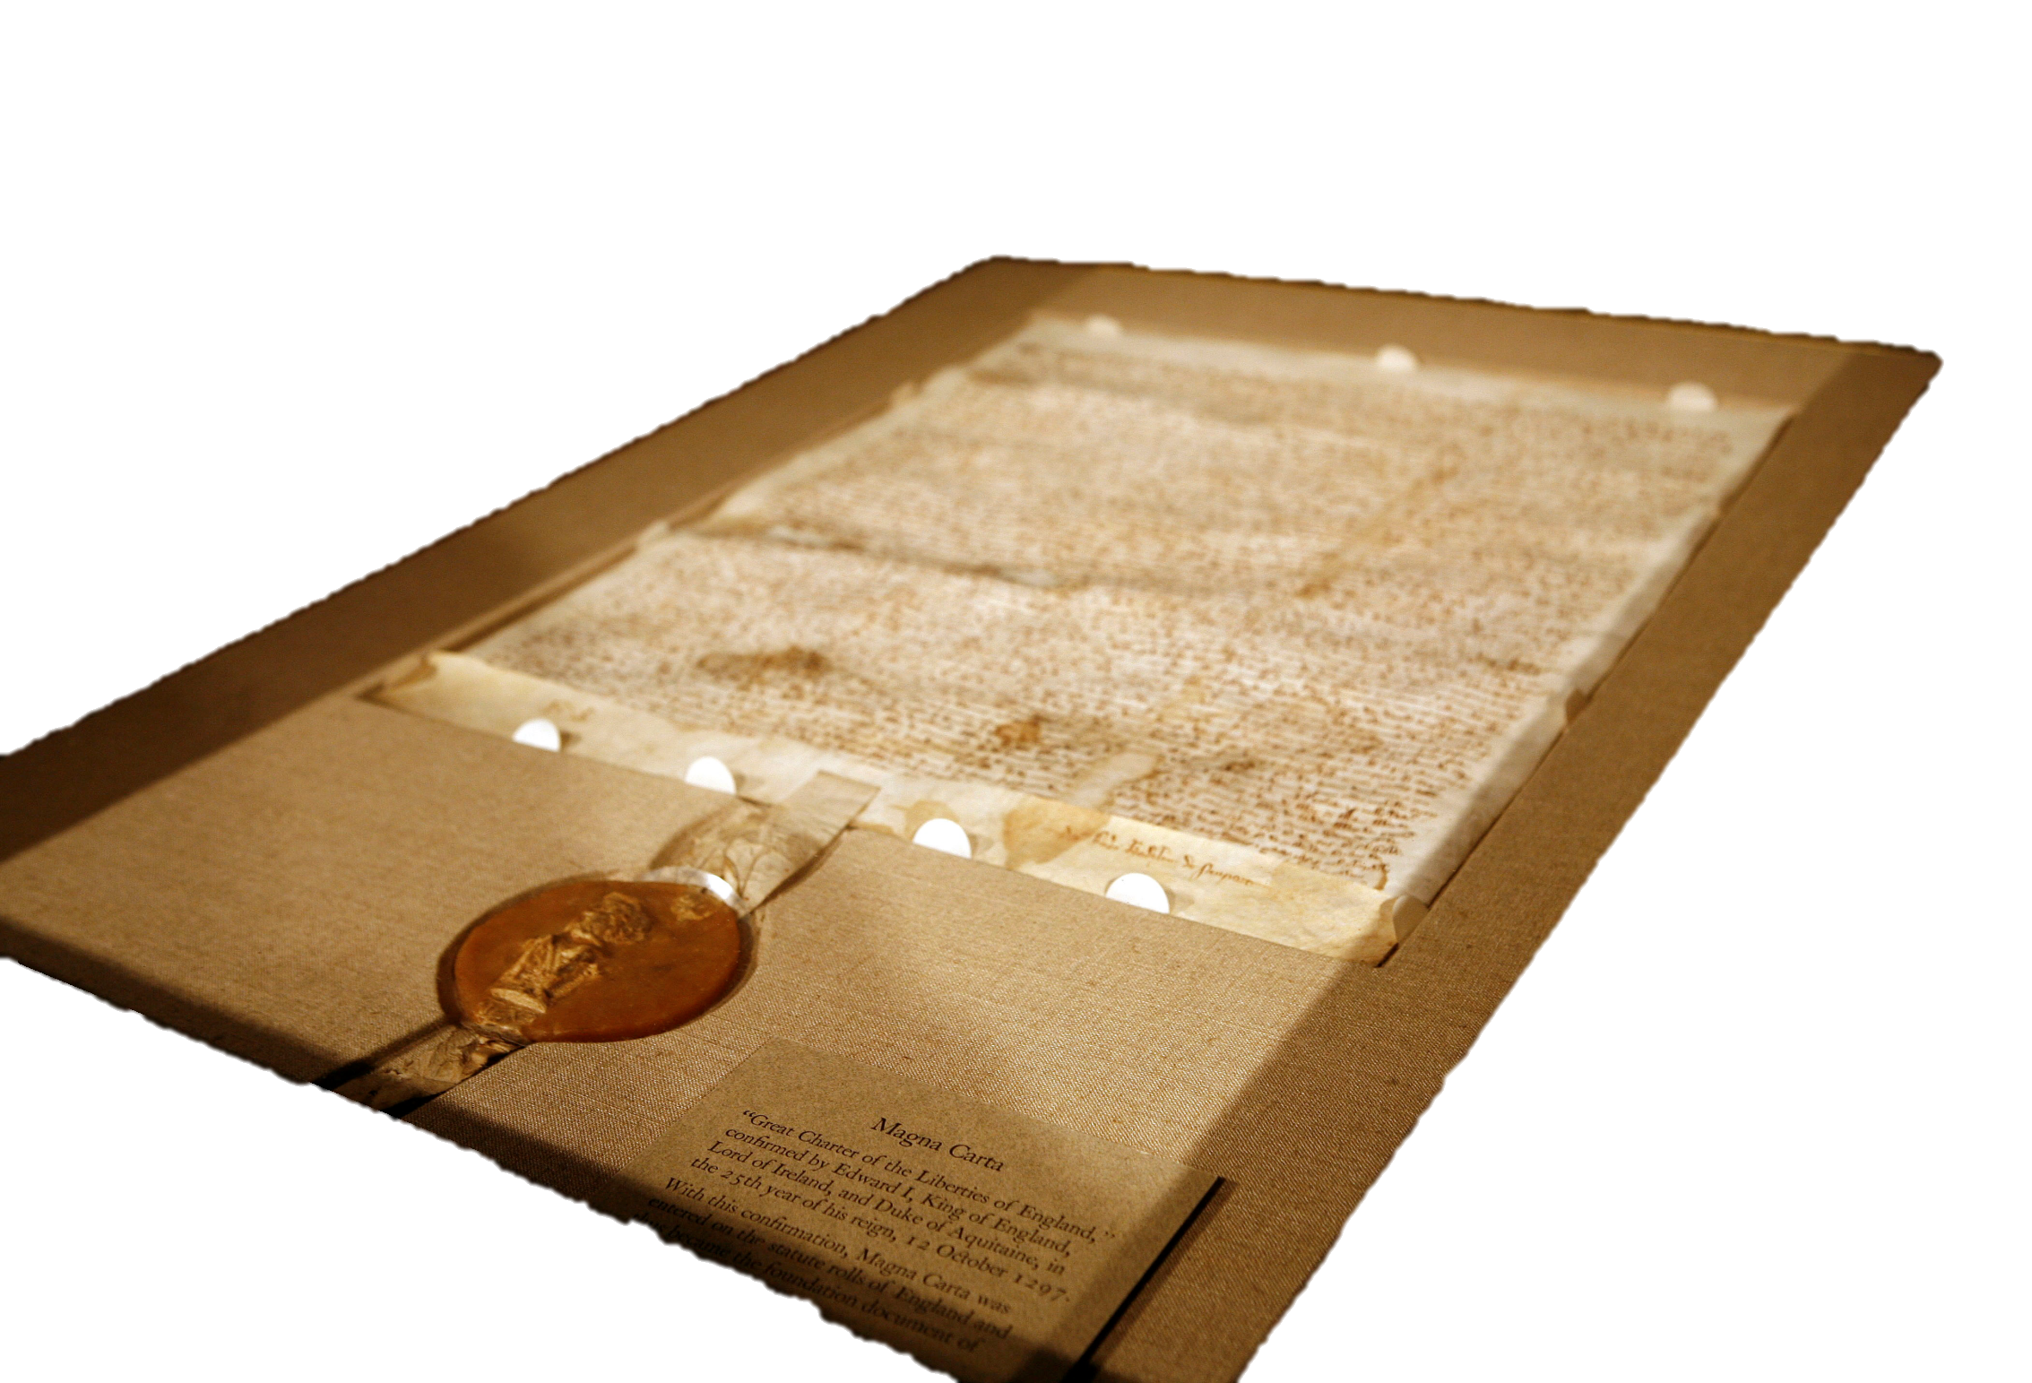
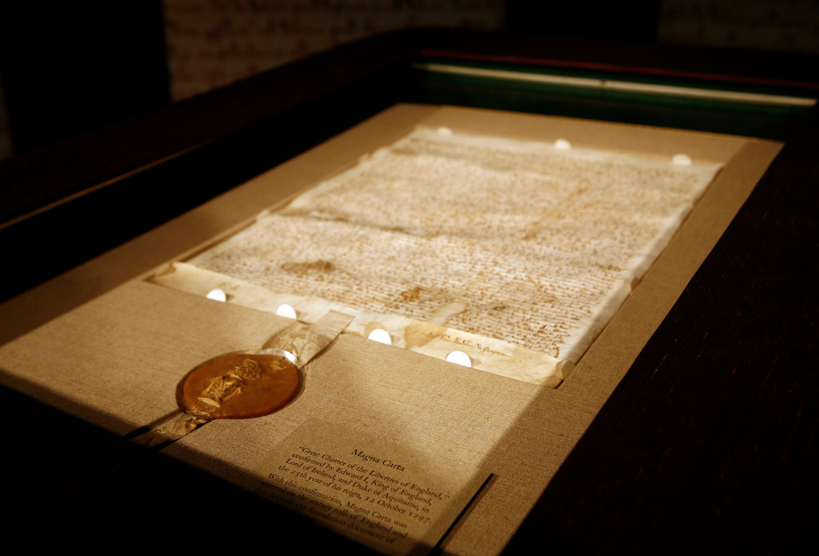
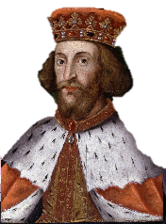
The Magna Carta
ARK AGES
What makes a hero?

Slide 10
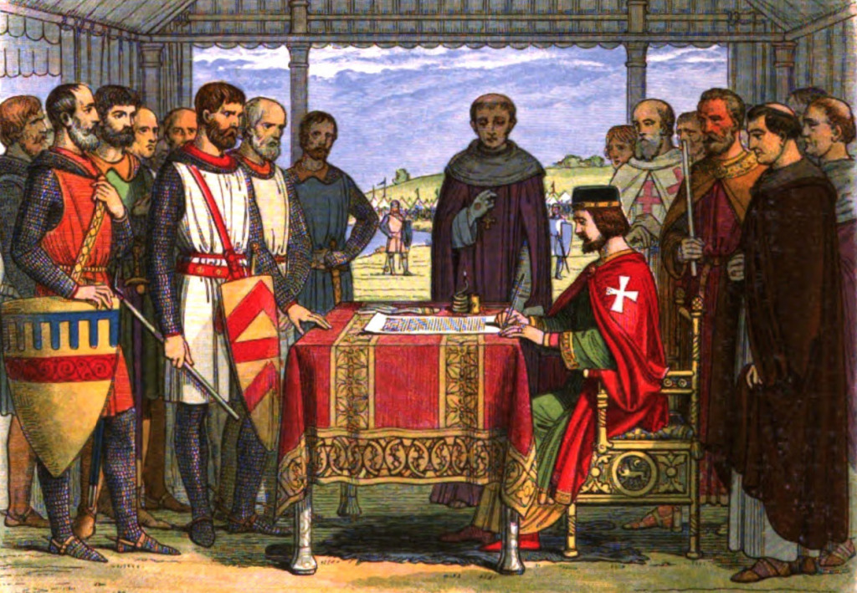
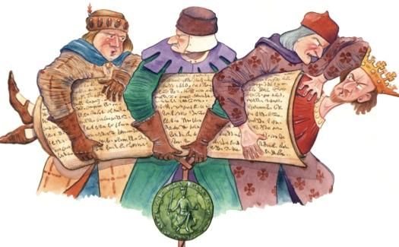
The nobles threatened to leave King John if he didn’t agree to their demands for rights.
ARK AGES
What makes a hero?
Notes:
7.6.5
After the church left the Nobles threatened to abandon King John too.
They wrote out a list of their demands called the Magna Carta.
They said either you agree to our demands or we leave and take our soldiers with us.

Slide 11
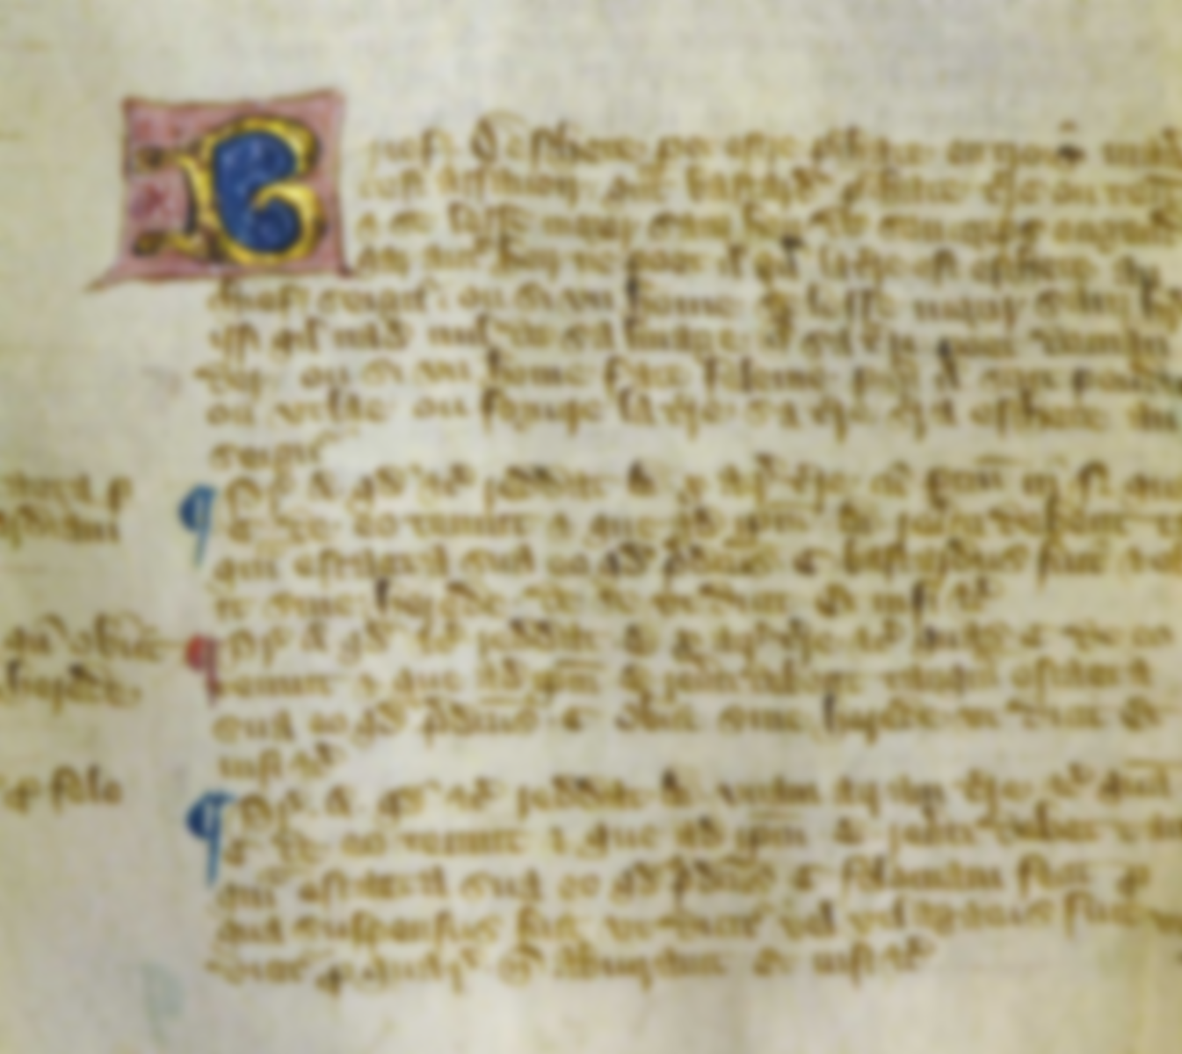
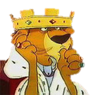
I, King John, accept that I have to rule according to the law.
So I agree:
1. Not to imprison nobles without trial
2. To have fair taxation for the nobles
3. To let nobles travel wherever they like
4. Not to interfere in Church matters
5. Not to take crops without paying for them
…and lot more things too!!
This is Important!
ARK AGES
What makes a hero?
Notes:
7.6.5

Slide 12

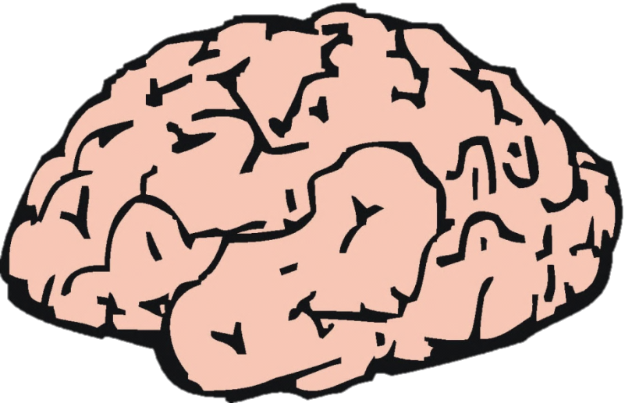
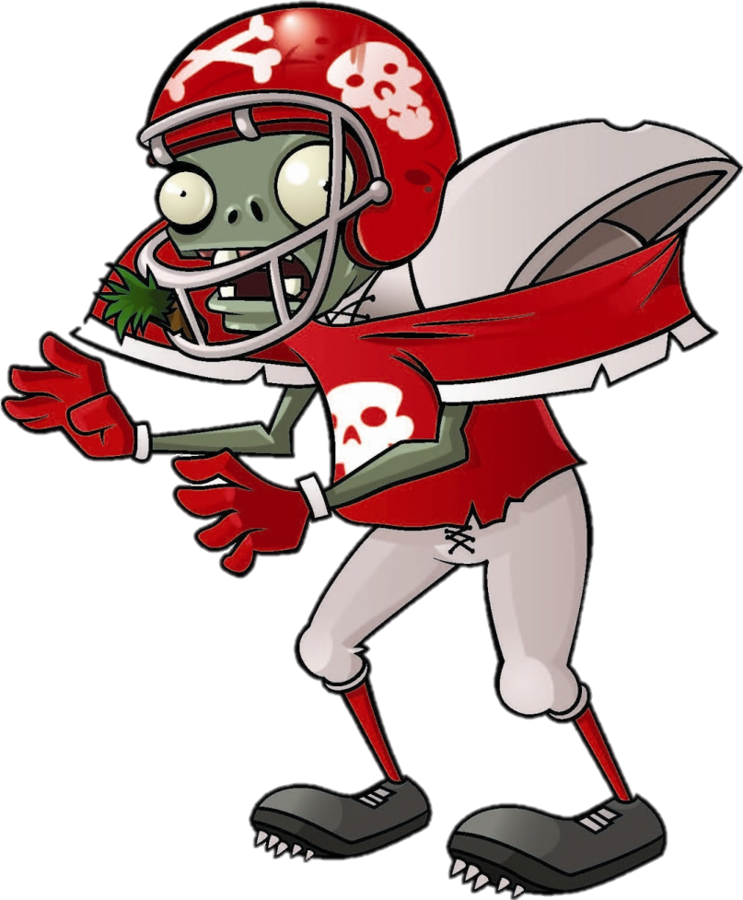

Brain
Snack
.
.
.
.

Slide 13


What do you think King John did after signing the Magna Carta?
Notes:
Fix this

Slide 14
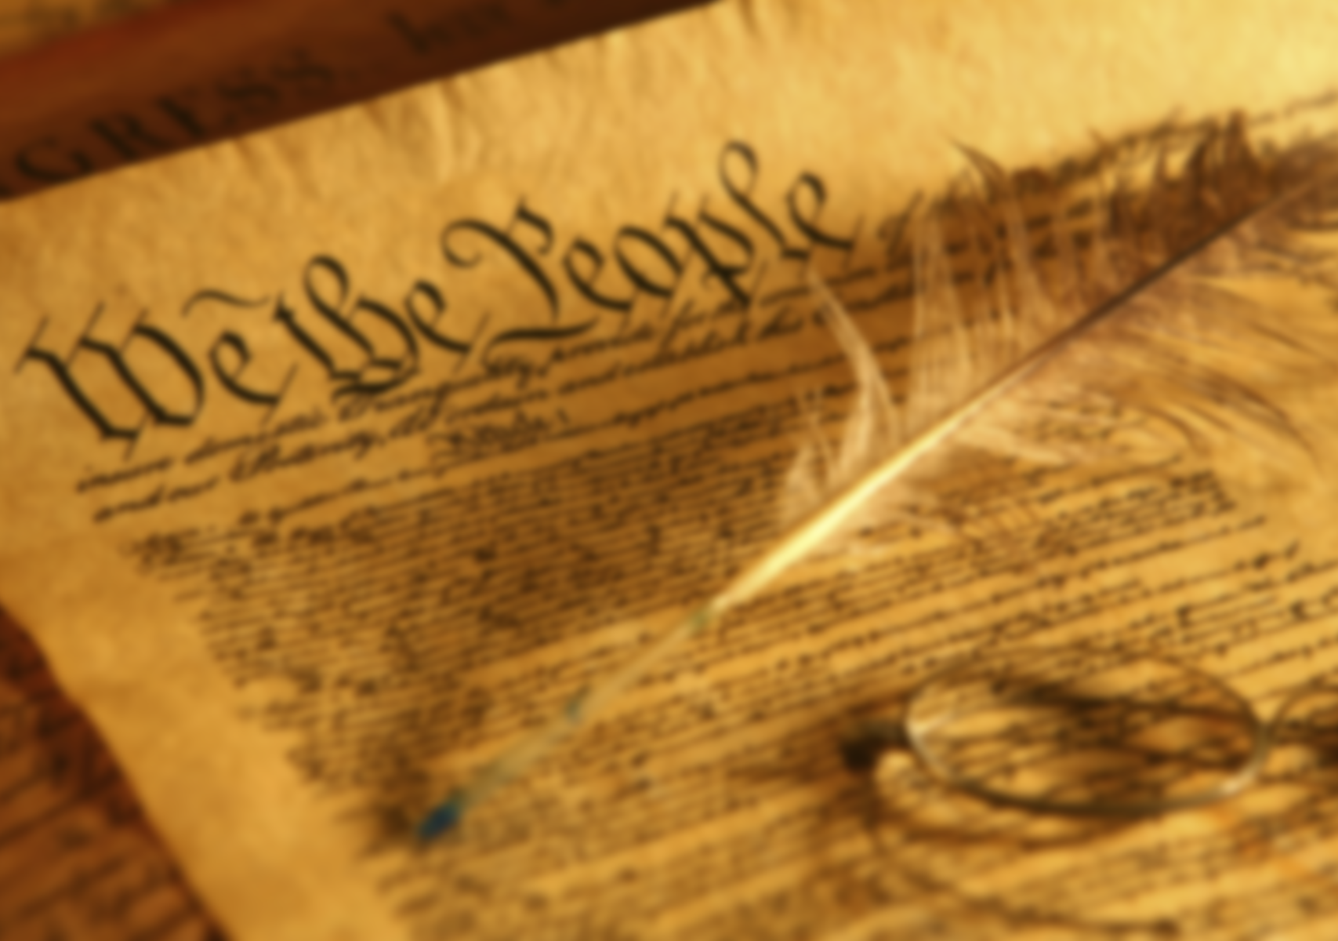
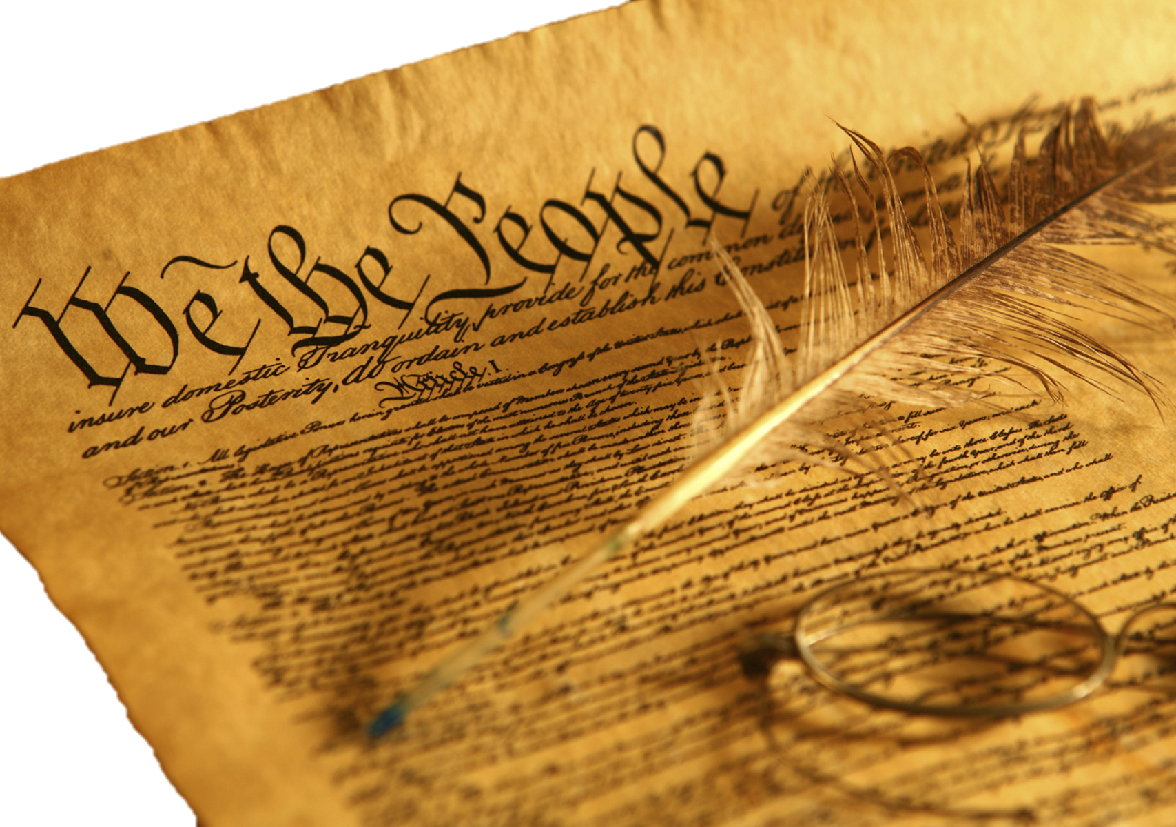
And then…
After signing the document – John ignored it.
Those who signed it were hunted down and killed.
Still, this set the stage for many of our rights and freedoms found in the Constitution.
ARK AGES
What makes a hero?
Notes:
Aftermath (maybe)

